Slide 1
Standards Paving the Way to Address Social Determinants of Health
HIMSS Interoperability & HIE Community
October 28, 2021 | 12:00PM -1:30PM CT

Slide 2

HIMSS Interoperability & Health Information Exchange Community
Comprised of nearly 8,000 HIMSS members
Connecting professionals committed to transforming health through standards-based interoperability and health information exchange
A dynamic community for sharing ideas, learning best practices and leveraging collaborative opportunities
https://www.himss.org/membership-participation/communities
Join Today

Slide 3






Thank you to our sponsor

Slide 4



Our Leadership Team
Herman Oosterwijk
Laura Young
President, OTech
Consulting Executive, healtheConnect Alaska

Slide 5


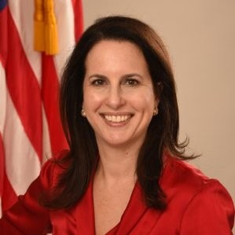



Meet Our Speakers
Lenel James
Samantha Wallack Meklir
JaWanna L. Henry, MPH
Evelyn Gallego, MBA, MPH, CPHIMS
Melissa A. Kotrys, MPH
Business Lead,
Blue Cross Blue Shield Association
Senior Policy Advisor, ONC
Analyst,
ONC
CEO,
Health Current
CEO and Founder, EMI Advisors LLC

Slide 6
Learning Objectives
Discuss the recent advancements in and recognize the importance of standards-based interoperability to integrate SDOH data with traditional health information.
Recognize the repository of open standards available for exchanging SDOH data and identify remaining gaps and challenges.
Describe current health information and technology related policies and government efforts intended to increase the impact of social services on overall wellbeing.

Slide 7
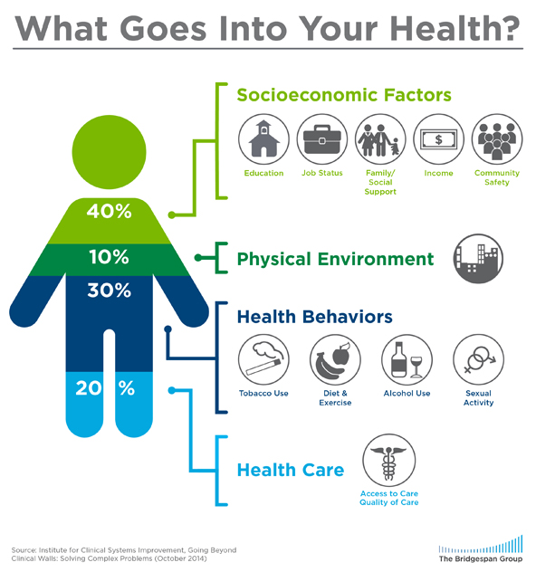



Why SDOH are Important
What Goes Into Your Health?
There is growing awareness that SDOH information improves whole person care and lowers cost. Unmet social needs negatively impact health outcomes.
Food insecurity correlates to higher levels of diabetes, hypertension, and heart failure.
Housing instability factors into lower treatment adherence.
Transportation barriers result in missed appointments, delayed care, and lower medication compliance
Addressing SDOH is a primary approach to achieve health equity.
https://www.cdc.gov/nchhstp/socialdeterminants/faq.html
https://www.bridgespan.org/insights/library/public-health/the-community-cure-for-health-care-(1)

Slide 8
Polling Question

Slide 9
Advancing Social Determinant of Health Data Use and Interoperability for Achieving Health Equity
Samantha Meklir
Senior Policy Advisor, ONC
Jawanna L. Henry
Analyst, ONC

Slide 10
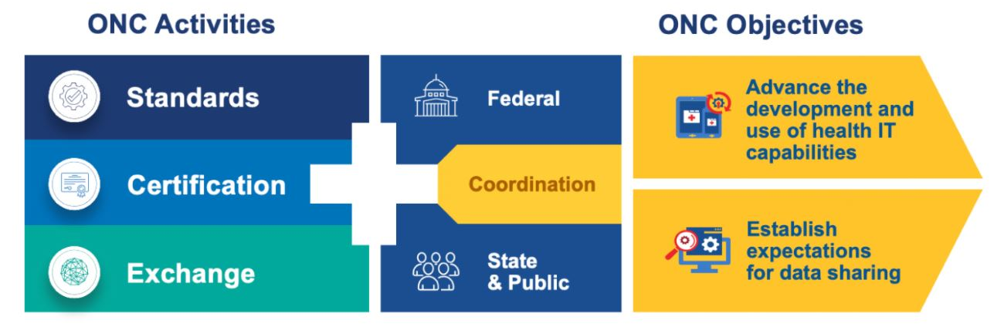
Office of the National Coordinator for Health Information Technology (ONC)
ONC is the principal federal entity charged with coordination of nationwide efforts to implement and use the most advanced health information technology and the electronic exchange of health information.
https://www.healthit.gov/topic/about-onc

Slide 11
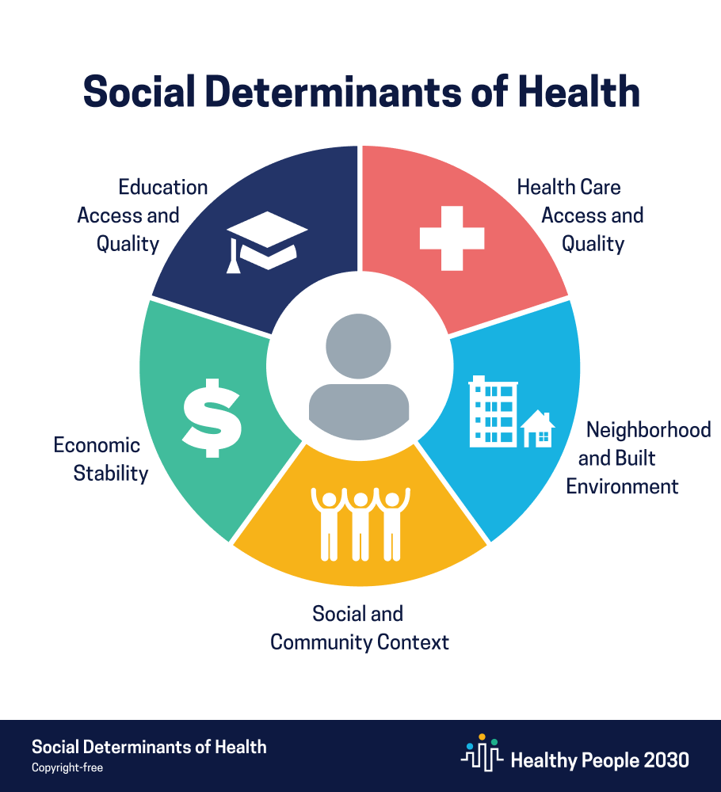
National Objectives: SDOH in HHS Healthy People
Healthy People 2030 sets data-driven national objectives to improve health and well-being over the next decade and was released by HHS on August 18, 2020. For the first time, it sets 10-year targets for objectives related to social determinants of health.
One of Healthy People 2030’s 5 overarching goals is specifically related to SDOH: “Create social, physical, and economic environments that promote attaining the full potential for health and well-being for all.”
Medical care is estimated to account for only 10-20 percent of the modifiable contributors to healthy outcomes for a population (National Academies of Medicine).
For more information, visit Healthy People 2030 & Objectives: Social Determinants of Health

Slide 12
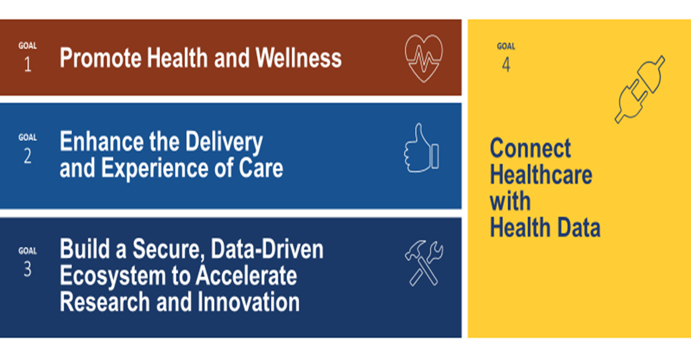
Federal Health IT Strategic Plan 2020-2025
The plan was developed in collaboration with over 25 federal organizations and public input; it is intended to guide federal health IT activities.
It includes an objective to integrate health and human services information and identifies federal strategies:
  Strengthen communities’ health IT infrastructure
  Foster greater understanding of how to use health IT
  Capture and integrate social determinants of
  health data into EHRs

Slide 13
ONC: Technology and Health Equity
Technology and Equity: ONC recognizes the further potential of data-driven technologies, including certified health IT, to impact health equity. Addressing inequities in social conditions, which can have a significant impact on health outcomes and access to care, can be supported in part through the collection, documentation, reporting, access and use of social determinant of health (SDOH) data.
Equity By Design: ONC takes an equity-by-design approach to our work, advancing the use of interoperable, standardized data to represent social needs and the conditions in which people live, learn, work, and play.
Equity and Broader Health Data: Health data, including data on race/ethnicity and social determinants of health, can help to identify health disparities and to inform efforts to improve health outcomes at an individual and population level. This data can also support (as examples): social care referrals, improved care delivery, person-centered decision making, research, population health improvement, and public health.
Data Gaps Impact Use: Gaps in available standardized social determinant of health and other relevant, non-clinical health data make it difficult to leverage available technology (EHRs, portals) to collect, share, and use it for individual and community health.

Slide 14
STANDARDS AND DATA
POLICY
Coordinate standards development, working closely with SDOs to identify and address gaps and emergent needs.
STANDARDS
Adopt standards, implementation specifications, and certification criteria to support priority use cases.
AND DATA
POLICY
Care Continuum
&
Health IT
INFRASTRUCTURE
INFRASTRUCTURE
IMPLEMENTATION
IMPLEMENTATION
Work with federal partners, states, and the health IT community to invest in interoperable systems.
Provide technical assistance, regulatory oversight, and governing support for national health care initiatives leveraging health IT.
ONC Approach to Support Interoperability

Slide 15
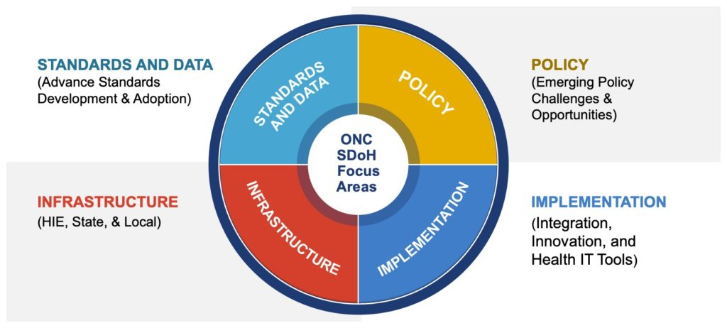
ONC SDOH Focus Areas

Slide 16
What if…..?
Imagine if….
Data captured at any point of care was structured and could be shared and reused by other service providers across community, state, and federal programs informing multiple patient care activities
Telehealth and social determinant of health data sources could be leveraged and integrated with other data sets to provide more insights on improved outcomes and program effectiveness
There were no obstacles for consumers in access to technology for virtual visits or for their health records
Every community was fully resourced with sufficient infrastructure/technology
Health and human services was fully integrated for holistic and equitable health and care

Slide 17
ONC Health IT SDOH Framework & State Equity Barriers
Barriers to health equity consist of institutional, structural, political, financial, and analytical challenges. Examples of state specific challenges and health IT opportunities include:
Health Equity Barrier* | State Health Equity Challenge* | Health IT Opportunity (Standards, Policy, Infrastructure, Implementation)
Structural | Lack of agency coordination | Align, harmonize data standards and electronic capture, use, and exchange
Institutional | Consumers of color face difficulty accessing social and health programs | Accessible, consumer facing technology for streamlined enrollment and adoption by trusted entities in community
Political | Lack of political will | Data on health inequities is used for transparent reporting and accuracy on current state problems
Financial | Lack of payments/market power | Health IT functions adopted to support value based, population health models incentivized for holistic health delivery
Analytical | Inconsistent data collection and accuracy on race, language, disability, etc. | Adopt and use existing health IT standards; align and harmonize standards.
*https://www.manatt.com/Manatt/media/Documents/Articles/State-Strategies-for-Overcoming-Barriers-to-Advance-Health-Equity.pdf

Slide 18
Closing the Technology Gap (Federal Perspective)
Focus on closing the “technology gap” by investing in and leveraging existing health IT infrastructure to improve care and access:
  adoption and implementation
  ongoing maintenance
  workforce development and training
These investments should support interoperability:
  Leverage nationally recognized standards for data
  Align with HHS and federal programs

Slide 19
Closing SDOH Data Gaps in Health IT
Gaps in available standardized social determinant of health and other relevant, non-clinical health data make it difficult to leverage available health IT to collect, share, and use it for individual, community health, research, activities to eliminate disparities, etc.
The Gravity Project is an ONC-supported, national public collaborative that develops consensus-based data standards to improve how the nation can use and share information on SDOH.
The Gravity Project team has an established and refined process to gather, review, and adjudicate robust data definitions for SDOH data documentation across four identified clinical activities: screening, diagnosis, goal setting, and interventions.
Federal and non-federal stakeholder opportunities exist to engage in SDOH terminology and standard piloting activities.
CMS State Medicaid Director’s Letter (21-001) encourages states to review and participate in the Gravity Project and the ONC ISA.

Slide 20
Closing Race/Ethnicity Data Gaps Using Existing Health IT and Existing Standards
Race and ethnicity data are important for many uses, such as informing effective treatment and patientcare, improving healthcare outcomes, research, and, identifying and eliminating health disparities to improve health equity.
Race and ethnicity data are also critical to informing national priorities, including efforts to advance racial equity and to support underserved communities including people of color and others who have been historically underserved, marginalized, and adversely affected by persistent poverty and inequality.
Health IT certified through the ONC Health IT Certification Program must have specific capabilities with respect to capturing and exchanging granular patient race and ethnicity data. These capabilities have been widely implemented in health IT certified.
  All health IT certified through the ONC Health IT Certification Program to the “demographics” certification criterion (45 CFR 170.315(a)(5)) must have the capability to record race and ethnicity at a detailed level of granularity consistent with the Centers for Disease Control and Prevention’s (CDC) Race & Ethnicity—CDC code system

Slide 21
ONC Standards and Data: Activities and Projects
ONC Interoperability Standards Advisory - compendium of health IT standards to drive adoption and use.
Fast Healthcare Interoperability Resources (FHIR®) and Open Application Programming Interfaces (APIs) - FHIR® is a modern, internet-based technology for exchanging health data; FHIR based standards and tools can collect, share, and exchange SDOH related information. APIs enable applications to interact with each other and share data; FHIR API is publicly available and free to use. ​
Certification Program- voluntary certification program established by the ONC to provide for the certification of health IT.

Slide 22
ONC Standards and Data: Certification Program
The ONC Health IT Certification Program provides assurance to purchasers and other users that a system meets the technological capability, functionality, and security requirements adopted by HHS. It supports the interoperable use of SDOH data that can be electronically captured, used, and exchanged and enables the health IT to support person-centered, holistic care
Since the release of ONC’s 2015 Certification Edition, 97 health IT developers have voluntarily certified 117 unique products to an SDOH-oriented certification criterion.
Social, Psychological, Behavioral Certification Criterion (“SDOH”)
  Financial resource strain
  Education
  Stress
  Depression
  Physical activity
  Alcohol use
  Social connection and isolation
  Exposure to violence (intimate partner violence)
Key Links for the Certification Program
  Certified Health IT Product List (CHPL)
  2015 Edition Cures Update Criteria
  Conditions & Maintenance of Certification

Slide 23
ONC Standards and Data: Activities and Projects
ONC Standards Bulletin- publication for healthcare stakeholders that includes updates about ONC health IT standards initiatives.​
  Standards Bulletin Issue 1-The inaugural ONC Standards Bulletin discusses the United States Core Data for Interoperability (USCDI) and the Standards Version Advancement Process (SVAP).​
  Standards Bulletin Issue 2- This issue focuses on health IT’s ability to capture a patient’s race and ethnicity using standardized terminology and codes included in the ONC certification criterion.​
  Standards Bulletin Issue 3- This issue focuses on the release of the United States Core Data for Interoperability Version 2 (USCDI v2) and ONC's vision for the future expansion of USCDI.
ONC United States Core Data for Interoperability (USCDI)- “minimum patient data set” for use and exchange in EHRs and other HIT.

Slide 24
What is the United States Core Data for
Interoperability (USCDI)?
  USCDI is a set of health data classes and constituent data elements that supports standardized exchange of health information across the national health care spectrum and is also used to align interoperability requirements and national priorities for health IT and health care.
  USCDI defined set of health data must be expressed in Certified Health IT modules and made available for exchange using certain exchange standards, such as FHIR or C-CDA.
  USCDI data elements represent individual concepts: medication, allergy, procedure, or health concern.
  Some USCDI data elements must be expressed using specific health IT vocabulary standards, such as SNOMED CT or RxNorm.
  USCDI is "content exchange standard agnostic" USCDI doesn't specify how and to what extent its elements are included in FHIR or C-CDA.
  USCDI is a required part of certain certification criteria in the 2015 Edition Cures Update and is also referenced in the context of information blocking.

Slide 25
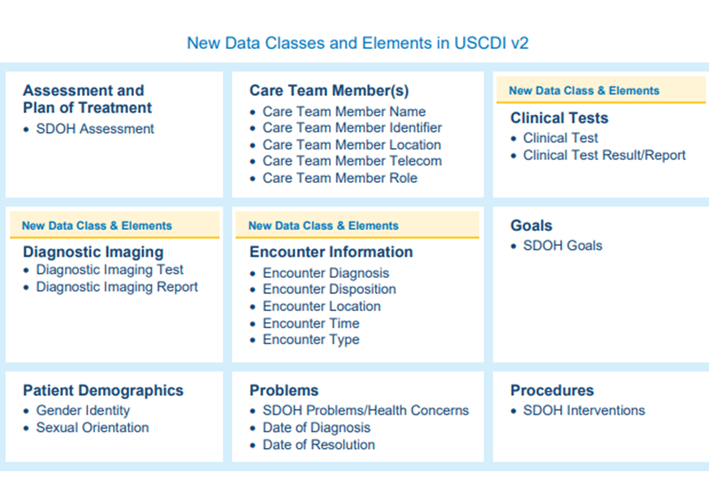
New to USCDI
Four new SDOH data and two new sexual orientation and gender identity elements added to the USCDI v2

Slide 26
ONC in Action
Public Health Emergency Response Related HL7® Standards, Solutions and Future Pandemics (Social Determinants of Health (SDOH) Standards)
Leading Edge Acceleration Projections (LEAP) Referral Management to Address Social Determinants of Health Aligned with Clinical Care
SDOH Information Exchange Toolkit
Public Health Informatics & Technology (PHIT) Workforce Development Program
Strengthening the Technical Advancement and Readiness of Public Health via Health Information Exchange Program (STAR HIE Program)

Slide 27


Visit the
ONC SDOH Webpage
for more information!
Samantha Meklir (samantha.meklir@hhs.gov)
Senior Policy Advisor, ONC
Jawanna L. Henry (jawanna.henry@hhs.gov)
Analyst, ONC

Slide 28
Consensus-driven Standards on Social Determinants of Health
Evelyn Gallego
CEO at EMI Advisors LLC,
Program Manager at Gravity Project

Slide 29
Agenda
Overview (WHY)
Project Scope (WHAT)
Accomplishments & Success Factors
How to Engage

Slide 30
Challenges in SDOH Data Capture and Exchange
Consent Management
Standardization of SDOH Data Collection and Storage
Data Sharing Between Ecosystem Parties
Access & Comfort with Digital Solutions
Concerns about Information Collection and Sharing
Social Care Sector Capacity and Capability
Unnecessary Medicalization of SDOH
https://www.nasdoh.org/wp-content/uploads/2020/08/NASDOH-Data-Interoperability_FINAL.pdf

Slide 31



















Enter the Gravity Project…
Goal - Develop consensus-driven data standards to support use and exchange of social determinants of health (SDOH) data.
FOOD
INSECURITY
TRANSPORTATION
INSECURITY
ELDER ABUSE
FINANCIAL
INSECURITY
UNEMPLOYMENT
STRESS
FOOD DESERTS
HOMELESSNESS
INTIMATE PARTNER
VIOLENCE (IPV)
INADEQUATE
HOUSING
NEIGHBORHOOD
SAFETY
VETERANS
HOUSING
INSTABILITY
MATERIAL
HARDSHIP
ENVIRONMENT
EDUCATION
SOCIAL
ISOLATION
RACISM
Domains grounded by those listed in the NASEM “Capturing Social and Behavioral Domains in Electronic Health Records” 2014

Slide 32
Project Scope
Screening/
Assessment
Develop, test, and validate standardized SDOH data for use in:
patient care
care coordination between health and human services sectors
population health management
public health
value-based payment, and
clinical research
Interventions
Diagnosis
Goals Setting
Gravity Project Scope: Develop data standards to represent patient level SDOH data documented across four clinical activities: screening, assessment/diagnosis, goal setting, and treatment/interventions.

Slide 33

Public Collaboration
HIE Vendors
HIO Organizations
CIE Organizations
Standards
Organizations
Gravity has convened over 2,000+ participants from across the health and human services ecosystem:
Clinical Provider Groups
Community-based Organizations
Standards Development Organizations
Federal And State Government
Payers
Technology Vendors
Public Calls 4-5:30 EST every other Thursday
Clinical Provider Organizations
PHR Vendors
Healthcare Professionals
Community Based Service Providers
Patient and Consumer Advocates
Community Based IT Vendors
Government (State and Federal)
Payors
Researchers
Public Health Agencies
https://confluence.hl7.org/pages/viewpage.action?pageId=46892669#JointheGravityProject-GravityProjectMembershipList

Slide 34

























Project Founders, Grants, and In-Kind Support To-Date
Yale School of Nursing
siren
https://confluence.hl7.org/display/GRAV/Gravity+Project+Sponsors

Slide 35
Gravity Overview: Two Streams
New Code Submissions
FHIR IG Testing
Coding Gap Analysis & Recommendations
FHIR IG Development
3
3
2
2
Terminology (SDOH Domains)
CODED VALUE SETS
Technical (HL7 FHIR)
Data Set Identification
1
1
Community & FHIR Coordination
4
4
Publication in NLM VSAC & ONC ISA
FHIR IG Ballot & Publication

Slide 36






Gravity 2021 - 2022 Roadmap
SEP | OCT | NOV | DEC | JAN | FEB | MAR | APR | MAY | JUN
SOCIAL
CONNECTION
TBD
Build, Disseminate, & Test
Build, Disseminate, & Test
Terminology
TBD
TBD
Gravity HL7 FHIR IG STU1 Published
Gravity HL7 FHIR IG STU2 Published
Gravity FHIR IG V2 Updates
Gravity FHIR IG STU2 Ballot
FHIG IG STU2 Ballot Reconciliation
Technical
Reference Implementation Updates
Gravity Connectathon
HL7 FHIR Connectathons
REAL WORLD Pilots Testing
Pilots
WE ARE HERE
Key
LOINC Code Submissions (MAR/ OCT)
SNOMED Code Submissions (MAY/DEC)
ICD-10 Code Submissions (JUN/DEC)
Goals/Interventions
10/29/2021
36

Slide 37



Terminology Workstream
Data Element and Coding Gap Analysis
All data are sorted across four activities into a master set.
For data within each domain, we ask:
  What concepts need to be documented across the four activities?
  What codes reflecting these concepts are currently available?
  What codes are missing?
Screening/
Assessment
Interventions
Diagnosis
Goals Setting

Slide 38
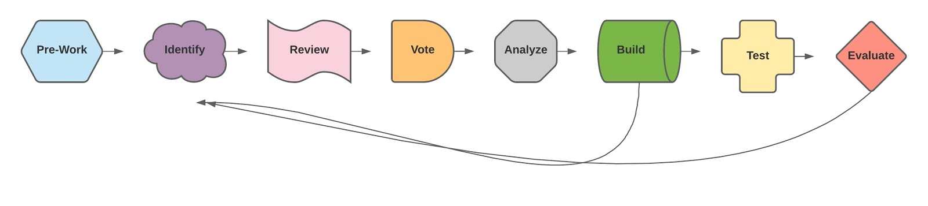
Consensus Terminology Development

Slide 39
Food Insecurity Terminology Build
FOOD
INSECURITY
FOOD DESERTS
Q. Within the past 12 months we worried whether our food would run out before we got money to buy more. LOINC 88122-7
A. Often true, Sometimes true, Never true, don’t know/refused. LOINC LL4730-9
PROCEDURE: Education about Child and Adult Food Program SNOMED 464201000124103
Screening/
Assessment
PROCEDURE: Provision of food voucher SNOMED 464411000124104
Food Insecurity Observation:
Food Insecurity SNOMED 733423003
Interventions
Diagnosis
Food Insecurity Diagnoses
ICD-10-CM: Food Insecurity Z59.42 *
REFERRAL: Referral to Community Health Worker SNOMED 464131000124100
Food Security, Has adequate number of meals and snacks daily, Has adequate quality meals and snacks*
Goals Setting
*Proposed. Not final.

Slide 40
Interventions Framework
Gravity Term | Definitions
Assistance/Assisting | To give support or aid to; help
Coaching | Method of instruction, direction, or promoting that can include demonstration, reinforcement, motivation and feedback to improve performance, or achieve a specified goal.
Coordination | Process of organizing activities and sharing information to improve effectiveness
Counseling | Psychosocial procedure that involves listening, reflecting, etc. to facilitate recognition of course of action/solution.
Education | Procedure that is synonymous with those activities such as teaching, demonstration, instruction, explanation, and advice that aim to increase knowledge and skills.
Evaluation of eligibility (for <x>) Subtype of Evaluation | Process of determining eligibility by evaluating evidence
Evaluation/Assessment | Determination of a value, conclusion, or inference by evaluating evidence.
Provision | To supply/make available for use
Referral | The act of clinicians/providers sending or directing a patient to professionals and/or programs for services (e.g., evaluation, treatment, aid, information, etc.)

Slide 41
Applicable Intervention Codes for Older American Act (OAA) Nutrition Programs
FOOD
INSECURITY
FOOD DESERTS
Intervention | SNOMED-CT Code/ Data Element
Assistance/ Assisting | 467801000124106: Assistance with application for Community meal Program 467731000124106: Assistance with application for Home-Delivered meals Program
Education | 464351000124105: Education about Congregate Meal Program 464211000124100: Education about Community Meals Program 464261000124102: Education about home-delivered meals program 464341000124108: Education about Senior Farmers’ Market Nutrition Program
Evaluation of eligibility | 467661000124106: Evaluation of eligibility for Community Meal Program 464621000124105: Evaluation of eligibility for home-delivered meals program
Provision | 464421000124107: Provision of home-delivered meals 464431000124105: Provision of medically tailored meals
Referral | 464151000124107: Referral to Congregate Meal Program 464081000124100: Referral to home-delivered meals program 464091000124102: Referral to medically tailored meal program 464171000124102: Referral to Senior Farmers’ Market Nutrition Program
https://www.nlm.nih.gov/healthit/snomedct/us_edition.html
41

Slide 42
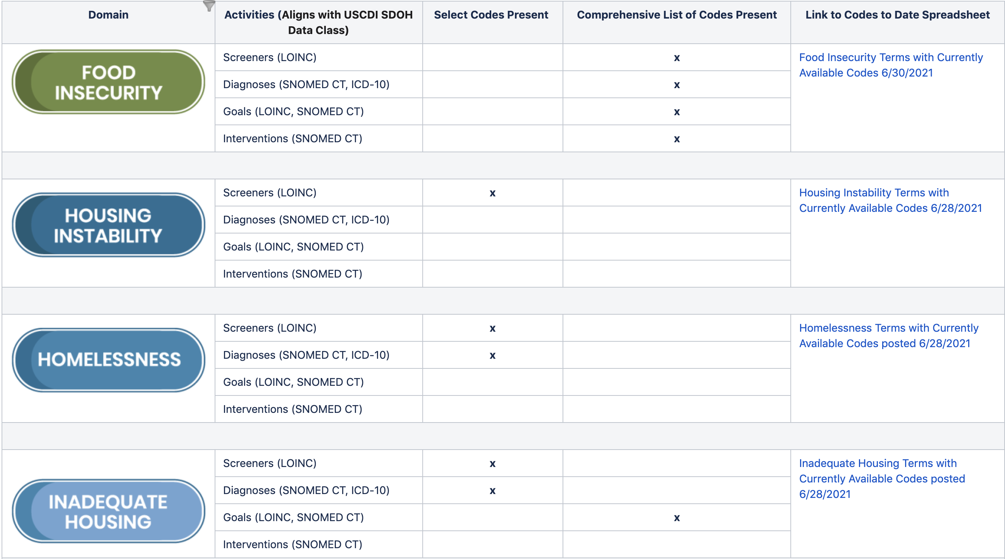
SDOH Data Elements and Status
Links to spreadsheets with all current released and implementable code
Updates after every terminology release (LOINC, SNOMED, ICD-10-CM)
https://confluence.hl7.org/display/GRAV/SDOH+Data+Elements+And+Status

Slide 43

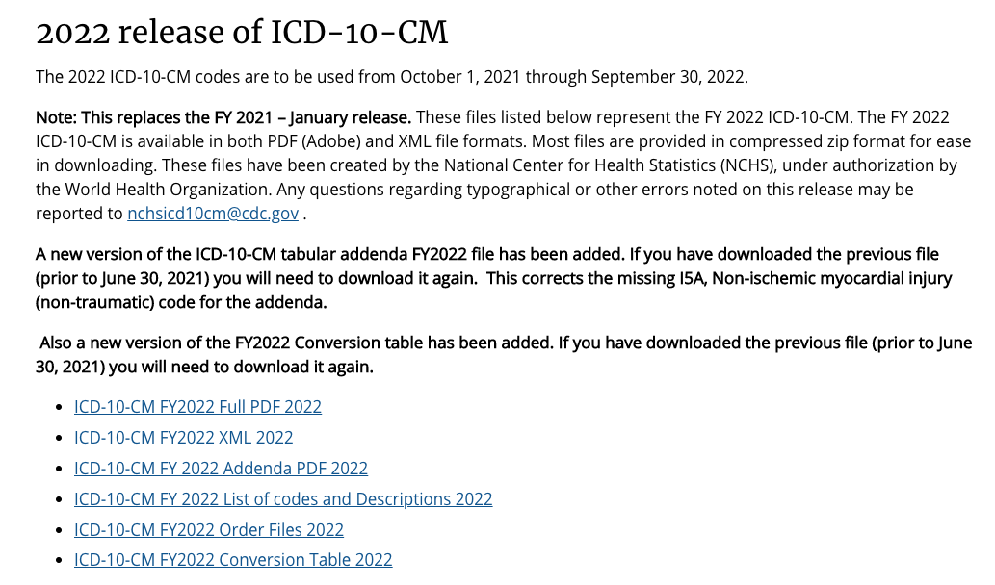
NEW! 2022 Release of ICD-10 CM
Gravity Project submission for new and updated education, food insecurity, and housing ICD-10 CMS codes were approved for implementation beginning October 1, 2021.
https://confluence.hl7.org/display/GRAV/ICD-10+Coding+Submissions
https://www.cdc.gov/nchs/icd/icd10cm.htm

Slide 44

Gravity Project Data Use Principles for Equitable Health and Social Care
Improving Personal Health Outcomes
Improving Population Health Equity
Ensuring Personal Control
Designing Appropriate Solutions
Ensuring Accountability
Preventing, Reducing, and Remediating Harm
https://confluence.hl7.org/display/GRAV/Gravity+Data+Principles

Slide 45

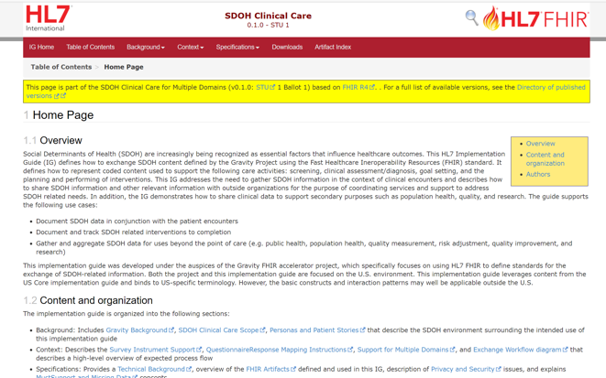
HL7 SDOH Clinical Care FHIR Implementation Guide
This is a framework Implementation Guide (IG) and supports multiple domains
IG support the following clinical activities
Assessments
Health Concerns / Problems
Goals
Interventions including referrals
Consent
Aggregation for exchange/reporting
Completed January 2021 ballot as a Standard for Trial Use Level 1 (STU1)
Published as STU v1 in August 2021
http://hl7.org/fhir/us/sdoh-clinicalcare/STU1/

Slide 46
Gravity FHIR IG Scope
Outcomes (Quality Measures)
Document SDOH data in conjunction with the patient encounter and define Health Concerns / Problems.
Patient and provider establish SDOH related goals.
Plan, communicate, and track related interventions to completion.
Measure outcomes.
Establish cohorts of patients with common SDOH characteristics for uses beyond the point of care (e.g., population health management, quality reporting, and risk adjustment/ risk stratification).
Manage patient consent
5
4
6
1
Measure/Survey
Procedures Document Results (SNOMED-CT, CPT/HCPCS)
3
2
CBOs Execute
3
Interventions (SNOMED-CT, CPT/HCPCS)
3
Aggregation and Reporting
Consent
Plan/Assign
4
Goals (LOINC and SNOMED-CT)
2
5
Establish
Health Concerns / Problems (ICD-10-CM and SNOMED-CT)
1
Define
6
Assessment/Survey (LOINC coded)
1
http://build.fhir.org/ig/HL7/fhir-sdoh-clinicalcare/

Slide 47








Interoperability Glide Path: Domain Data Sets & Implementation Guides
Regulators
SDOH Data Sets
Fast Health Interoperability Resource
EHR Vendors
FOOD
INSECURITY
TRANSPORTATION
INSECURITY
ELDER ABUSE
Develop and test coded value sets for use in FHIR
FINANCIAL
INSECURITY
INTIMATE PARTNER
VIOLENCE (IPV)
Payers & Providers
FOOD DESERTS
HOUSING
INSTABILITY
MATERIAL
HARDSHIP
ENVIRONMENT
Patients
Refine, test, and ballot HL7® FHIR® SDOH Implementation Guide
HOMELESSNESS
UNEMPLOYMENT
STRESS
INADEQUATE
HOUSING
NEIGHBORHOOD
SAFETY
VETERANS
Clinicians
EDUCATION
SOCIAL
ISOLATION
RACISM
Registries/
Researchers
Clinical Interoperability Council
http://www.hl7.org/about/fhir-accelerator/

Slide 48








Success Factors—
Integration of Data Standards Into…
POLICY
(e.g., ONC USCDI, CMS Promoting Interoperability, State Medicaid Director Letters)
INNOVATION
New tools for capture, aggregation, analytics, and use.
PAYMENT MODELS
(e.g., CMMI SDOH Model)
PRACTICE
(e.g., repeatable process for adoption, implementation, and use of SDOH data at practice level).
PROGRAMS
(e.g., Medicare Advantage, Medicaid Managed Care, Hospital QRRP, MIPS).
GRANTS
(e.g., ACL Challenge Grant, ONC Health IT LEAP)
OTHER STANDARDS
HL7 FHIR Accelerators (DaVinci, Argonaut, CARIN)

Slide 49

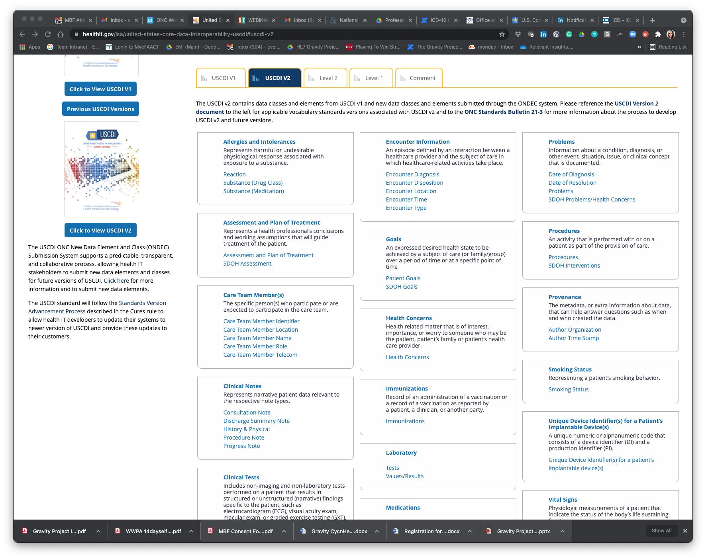
Policy Integration: Gravity USCDIv2 Submission
The Gravity Project formally made a submission to the ONC U.S. Core Data for Interoperability (USCDI) version 2 in October 2020.
On April 15, 2021, HITAC approved and forwarded recommendation to ONC
On July 9, 2021, ONC included the SDOH data class in the USCDI V2 publication
https://www.healthit.gov/isa/united-states-core-data-interoperability-uscdi#uscdi-v2

Slide 50
Join the Gravity Project!
Give us feedback on the Data Principles: https://confluence.hl7.org/display/GRAV/Gravity+Data+Principles
Submit SDOH domain data elements (especially for Interventions): https://confluence.hl7.org/display/GRAV/Data+Element+Submission
Help us with Gravity Education & Outreach
Use Social Media handles to share or tag us
to relevant information
@thegravityproj
https://www.linkedin.com/company/gravity-project
Learn More
https://confluence.hl7.org/display/GRAV/Join+the+Gravity+Project
Workgroup meets bi-weekly on Thursdays’ 4:00 to 5:30 pm ET
SDOH FHIR IG Workgroup s. 3:00 to 4:00 pm ET
Help us find new sponsors and partners
Partner with us on development of blogs, manuscripts, dissemination materials

Slide 51






Gravity PMO Team
Evelyn Gallego
Program Manager
evelyn.gallego@emiadvisors.net
Mark Savage
SDOH Policy Lead
MarkSavage.eHealth@pacbell.net
Lenel James
Payer Advisor
@egallego
linkedin.com/in/egallego/
@SavageMeHealth
linkedin.com/in/mark-savage-34aa03126/
linkedin.com/in/lenel-james-4435ba
Daniel Vreeman
Technical Director
dvreeman@rti.org
Sarah DeSilvey
Clinical Informatics Director
sarah.desilvey@med.uvm.edu
@djvreeman
@sarcandes
https://www.linkedin.com/in/danielvreeman/
linkedin.com/in/sarah-desilvey-fnp/

Slide 52
Arizona’s SDOH Program:
CommunityCares
Melissa Kotrys
Chief Executive Officer, Health Current

Slide 53
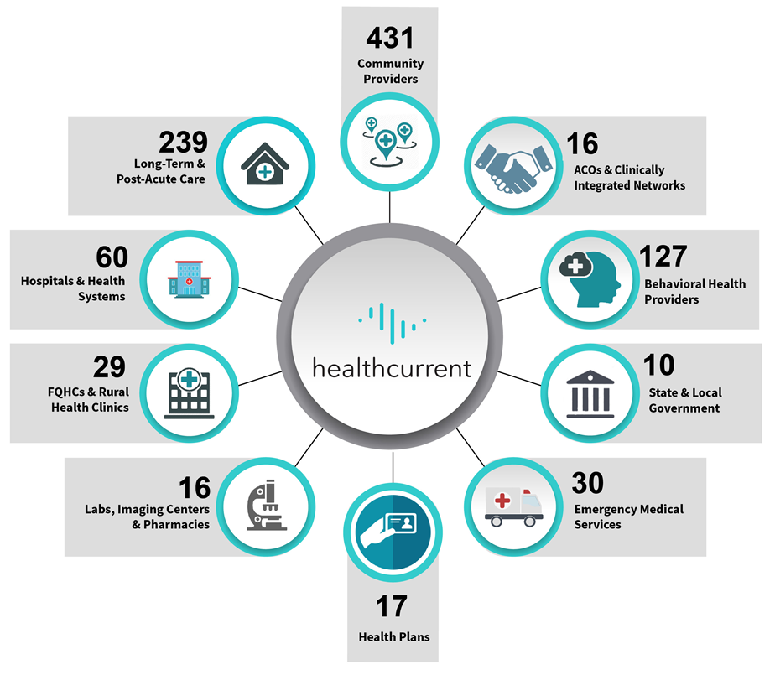
Who is Health Current?
975
HIE Participants and growing
as of 10/11/2021
Data available on 14+ million
2,400+ Active Portal Users
278 Data Sources
30+ million transactions received monthly
Data Source: https://healthcurrent.org/hie/the-network-participants/

Slide 54

Arizona's SDOH Referral System: CommunityCares
A Single, Statewide Solution for all Arizonans

Slide 55
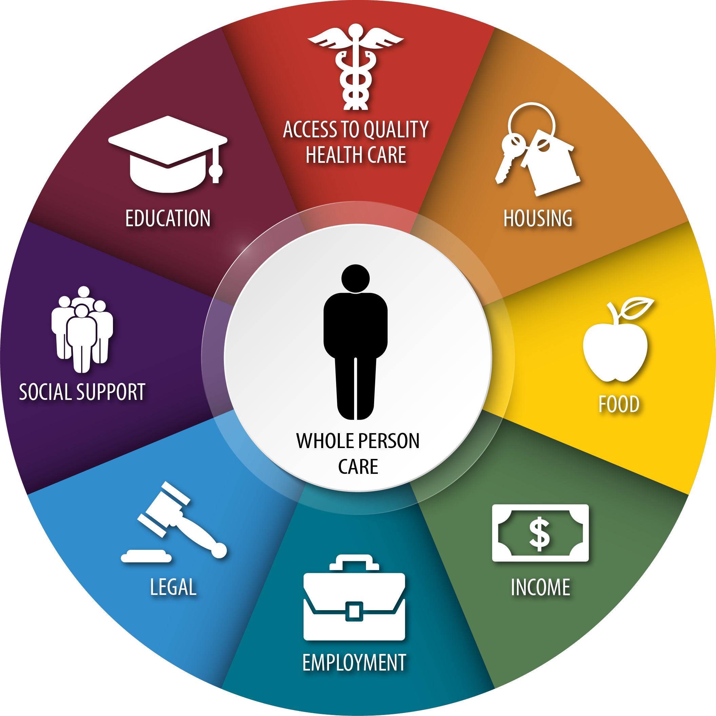
Az Medicaid (AHCCCS) Whole Person Care Initiative (WPCI)
Officially launched the Whole Person Health Initiative in November 2019.
Focused on role social risk factors play in influencing individual health outcomes.
Exploring options for advancing WPCI through maximization of AHCCCS’s current benefit package.

Slide 56

Arizona CommunityCares Program
Partners

Slide 57

CommunityCares Purpose
Connecting our communities.
Improving health outcomes with a whole-person care mindset.
Data-driven approach.
To implement a statewide referral system to be used by healthcare providers and community-based organizations that facilitates closed loop SDOH referrals for all Arizonans, based on identified needs.

Slide 58
Data Model
The NowPow platform that hosts CommunityCares is modeled to meet the needs of the community
NowPow participates on the Gravity Project Committee and is aligned with the SDOH domains & standards outlined by Gravity & USCDI
NowPow has developed its own APIs using FHIR standards and can map to z-codes and LOINC codes

Slide 59
Barriers to SDOH Data Integration
Most electronic health information systems are primarily designed to capture clinical data
Where does discrete data from an SDOH system live in an EHR?
Without a place to capture discrete data, information is passed in text format on documents, such as pdf
Those systems that have placeholders that can integrate discrete SDOH data points do not follow an industry standard

Slide 60
Statutory, Regulatory & Policy Challenges
A Foundational Goal
All users of the system – including healthcare providers and CBOs – all have the same level of access for referrals to facilitate the “no wrong door” approach. This requires designing the system in a way that the appropriate data is shared with the appropriate types of organizations.
The Challenges
Most SDOH services are provided by community-based organizations who do are not covered entities as defined by HIPAA.
Arizona health information organization (HIO) law views an SDOH system like CommunityCares as an HIE that must follow Arizona’s opt-out laws.
The fact that not all users can have access to the same data can limit what care coordination is possible, but is critical for compliance with HIPAA.

Slide 61
Advancing SDOH Standards Integration
SDOH standards are needed for the data exchange. This is happening now, but many efforts are still moving forward without final standards in place.
Standards aren’t enough… we need wide adoption of standards. How can we leverage current standards enforcement mechanisms to support SDOH?
An alternative approach: How about developing a standard CCD for SDOH?
Ultimately, we need standards finalized for all needed SDOH data elements and used widely within the HIT ecosystem to support accurate, consistent and reliable community data

Slide 62

Questions?
Melissa A. Kotrys
Chief Executive Officer
melissa.kotrys@healthcurrent.org
Twitter: @melissakotrys
www.contexture.org
www.healthcurrent.org
www.corhio.org

Slide 63
Q&A
Lenel James
Samantha Wallack Meklir
JaWanna L. Henry, MPH
Evelyn Gallego, MBA, MPH, CPHIMS
Melissa A. Kotrys, MPH
Business Lead,
Blue Cross Blue Shield Association
Senior Policy Advisor, ONC
Analyst,
ONC
CEO,
Health Current
CEO and Founder, EMI Advisors LLC

Slide 64

Thank you!
Contact email:
Interoperability & HIE Community interop@himss.org

